Slide 1

Conceptual Data Modelling
For MOI

Slide 2
Why a Conceptual Data Model?
A Conceptual Data Model (CDM) documents the business data for all users of the data.
Identifies and describes a common understanding of the business data.
Removes ambiguity by identifying and uniquely naming unique data.
E.g. different data / same name, and same data / different names.
Describes the business data in terms that are independent of any implementation or technology.
Acts a source of information for building technical implementations.
E.g. for Administration systems, Business Intelligence systems, etc.
Provides a data dictionary of business data for users of the data.
Business ownership – largely defined, and completely owned, by the business data owners.

Slide 3
What is captured?
Data definitions
Described in terms recognisable and understandable to all users of the data.
Business entity types (real world objects that the business interacts with).
E.g. Client Company, Member, Intermediary, Policy, Claim, Life Claim, etc.
Entity sub-types (generalisations) and super-types (specialisations).
E.g. Policy versus Income Protection Policy.
Relationships and dependencies between entity types.
E.g. A Client Company must be introduced to Bupa by an Intermediary.
An Intermediary can introduce zero or more Client companies.
A Member can make zero or one Life Claim.
An Intermediary branch cannot exist without the corresponding Intermediary.
Cardinality of relationships – minimum / maximum.
E.g. A Client Company is introduced by exactly one Intermediary.
A Policy assures at least one Life.
Attributes of each entity type.
E.g. Member Name, Policy Number, Claim Amount.
Details of attributes.
E.g. data type, length, precision, scale, mandatory/optional, validation rules, default values,
definition commentary including examples.

Slide 4
How is it represented?
Diagrammatically: -
  Boxes representing entity types.
  Lines representing relationships.
  ‘Crows Feet’ representing relationship cardinality.
  Unique identifiers: Primary and alternate key attributes.
  Relationships: Foreign key attributes.
  Labels for entity type and attribute names.
  Data types, mandatory/optional
Textually (business descriptions)
  Business descriptions.
  Validation rules, default values.

Slide 5
A simple CDM example
NB: detailed attribute data hidden in this display.
Client Company
primary
Policy
Client Id
key
Policy Number
Client Name
holds
Client Id (FK)
Intermediary Id (FK)
held by
sub-type
Policy Start Date
discriminator
Policy Renewal Date
attribute
mandatory
Policy Type Code
introduced by
optional
foreign
sub-type
key
indicator
Policy Type Code
sub-type
introduces
discriminator
Intermediary
attribute
Intermediary Id
alternate
Intermediary Number (AK1.1)
key
Intermediary Name
CIC Policy
Life Policy
Income Protection Policy
Policy Number (FK)
Policy Number (FK)
Policy Number (FK)
Client Id (FK)
Client Id (FK)
Client Id (FK)
CIC Specific Attributes
Life Specific Attributes
IP Specific Attributes

Slide 6
Diagramming convention
Entity types: -
  Strong (independent)
  Weak (dependant)

Slide 7
Diagramming convention
Relationships: -
  Shown with connecting lines.
  Identifying (child relies on parent) show as solid lines.
  Non-identifying (child doesn’t rely on parent) as broken lines.

Slide 8
Diagramming convention
Cardinality: -
  Indicated using crow’s feet symbols at each end of the relationship line.
  The following symbols are used:-
    Zero
    One
    Many

Slide 9
Diagramming convention
Cardinality indicators are usually combined to indicate minimum and maximum cardinality at each end of a relationship. E.g.:-
  One to Zero-or-One
  One to Zero-One-or-Many
  Zero-or-One to Zero-One-or-Many
  NB: “zero” indicates optionality at that end of the relationship.

Slide 10
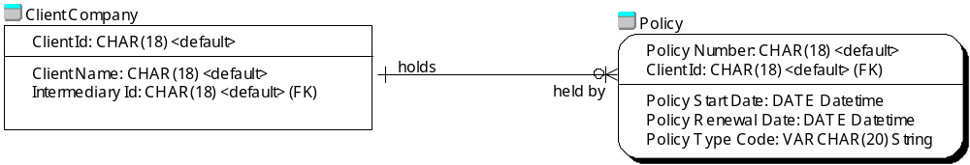
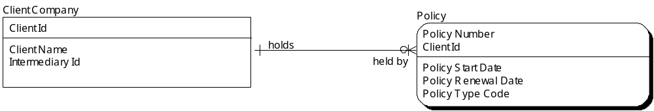
Diagramming convention
Variable levels of display
  Maximal
  Minimal

Slide 11
Conceptual Data Model Development
Through iterations - often subject area, or user group.
IS production with business input, review, authorisation and ownership.
Identification of Primary, Alternate and Foreign key attributes.
Business descriptions of attributes added.
Specification of attribute detail (data type, length, validation rules, default values, etc).
Updated over time as knowledge of existing data grows.

Slide 12
High Level Data Model
First step towards defining the fully attributed Conceptual Data Model.
Expanded when moving to fully attributed Conceptual Data Model development.
Entity types, super-types, sub-types and relationships only.
Developed quickly from business knowledge.

Slide 13
A simple High Level example
Client Company
Policy
holds
held by
sub-type
discriminator
attribute
introduced by
sub-type
indicator
Policy Type Code
introduces
Intermediary
CIC Policy
Life Policy
Income Protection Policy

Slide 14
After business CDM sign-off
IS deliverables with business relevance: -
  Definition of the MOI data warehouse physical presentation layer model – the layer accessible by reporting/query tools.
  Definition of Cognos 8 reporting model.

Slide 15
After business CDM sign-off
Other IS-internal deliverables
  Definition of ETL (extract, transform, load) processes to populate MOI database.
  Physical MOI data layer data model.
  Other design documents.

